Slide 1
From Port Information Guide to Avanti
An interesting journey

Slide 2
What is Avanti
Notes:
Avanti stands for Access to Validated Nautical Information.
Avanti is an on-line web based application that provides validated nautical information for port users. Avanti helps Harbour Masters to manage their nautical port information so that this information is always available, up-to-date and accessible to all port users.
One international format, as opposed to numerous different local solutions, will best serve port data users.
Port data users vary from hydrographic offices, shipping lines, local agents, terminals, traders, ship brokers, pilots, VTS systems, etc. etc.
With this in mind the Avanti proof of concept system has been built by UKHO and with the IHMA and others is developing an internationally agreed standard definitions. This serves shipping that needs to work from port to port worldwide while preferably using common standards.

Slide 3
Why?
Notes:
Industry consultation learned:
Good nautical port information is the foundation of safe, efficient port use in the most environmentally sensitive and collaborative manner
Berth to Berth passage planning is compulsory according IMO
It is likely that the number of qualified mariners in the port-industry will decrease. Therefore it is important to create a standard that allows all parties to understand one another by having clear definitions, published in an authorized book such as the Mariners Handbook
Ships will grow even bigger in size, as a result safety margins are getting smaller. E.g. due to larger draughts, the Under Keel Clearance is getting smaller, and therefore the need for precise depth information is increasing.
With the increasing number of digital charts and publications, the frequency of updating rises dramatically
Ships have been fitted with more satellite communication systems, increasing the need for digital port information

Slide 4
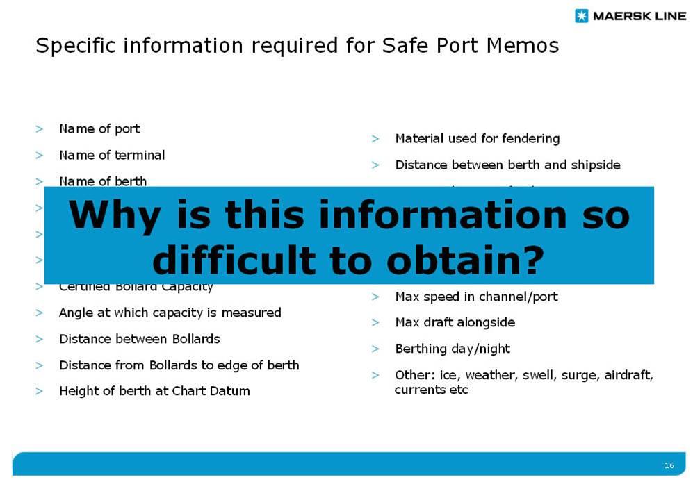
Request from industry
Notes:
2006 Malta – Bjarne Foldager
2008 St Petersburg – BP Shipping presentation, LMIU and UKHO investment
2012 Cork – UKHO Avanti investment
2014 Gent – Shell Shipping presentation, highlighting that nautical port information is necessary for their shipping business process
2016 Vancouver – Industry Taskforce pushing Avanti, consisting out of leading shipping departments of both the bulk and container industry

Slide 5
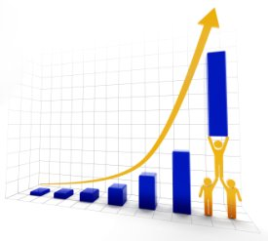
Fleet efficiency
Notes:
There is an increased need to improve the port call.
Sailing port to port has reached the optimum in terms of scale optimization and speed optimization.
Next step is port call optimization: realizing maximum amount of cargo on board, most efficient speed to the port, and minimum hours in the port.
However this requires nautical port information.

Slide 6

Fleet interoperability
Notes:
Shipping lines, especially in the container branches, have more alliances and mergers than ever before.
Exchanging port data has become a nightmare, as all databases have different formats, definitions and values.
Impossible to make it one database.

Slide 7
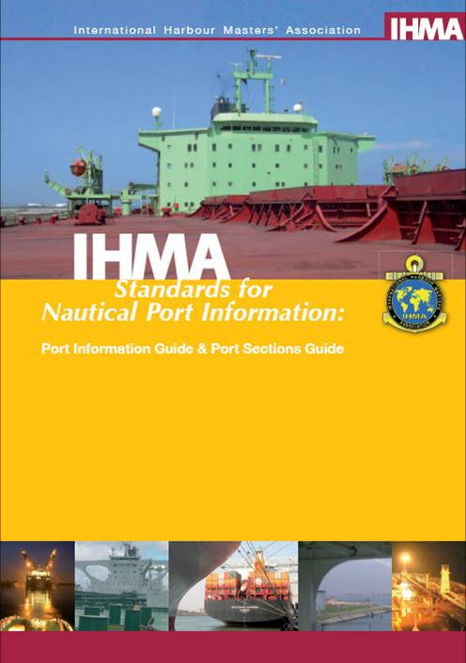
Start 2006
Notes:
It started with an industry consultation in 2006

Slide 8
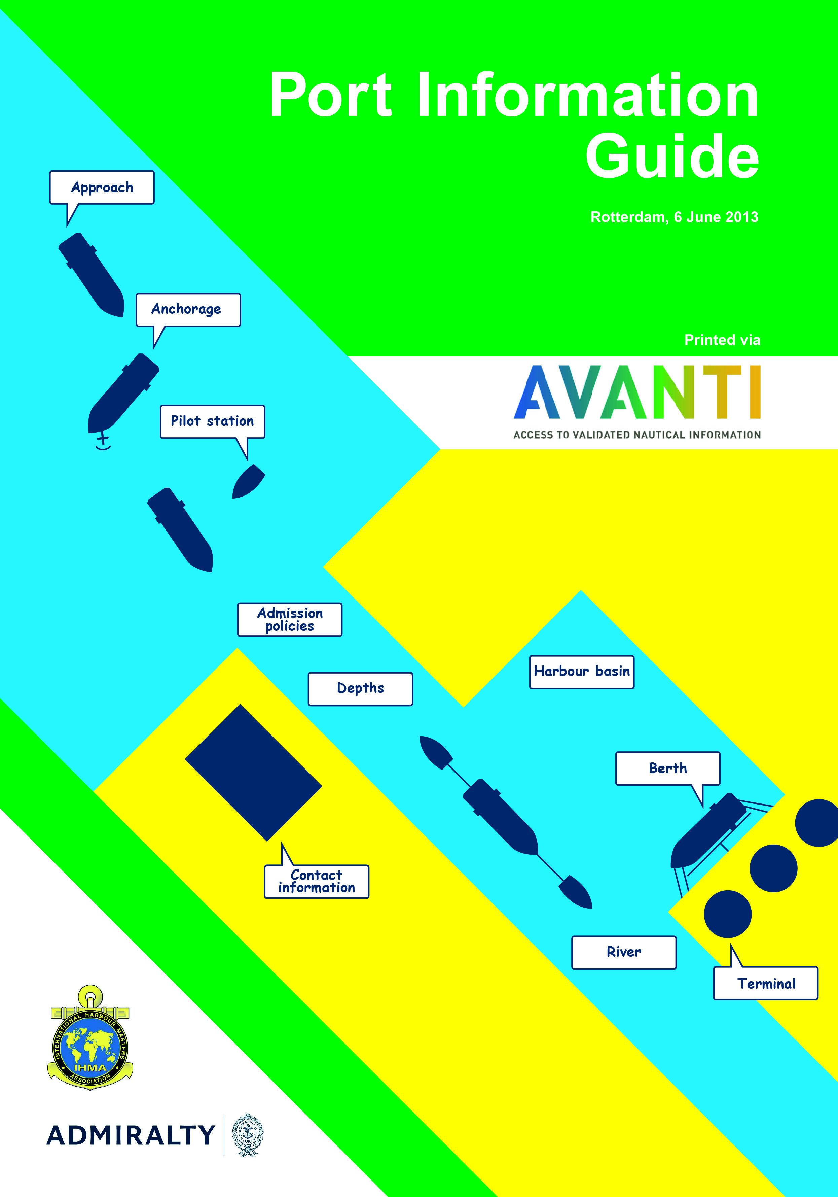
Status 2016
Notes:
Followed by the first Port Information Guide in 2008, based on a word template.
Followed by the first Port Sections Guide in 2010
And based on both templates the first web application in 2012
Based on those experiences the standardization process started in 2014

Slide 9
What have we learned?
Notes:
Customers request quality informaiton. Our customers have repeatedly indicated that the quality of the information is leading. If they base their decisions on the information, they need an indication of the quality first.
Port that maintain a lot of data, like to manage the information in their own data base
The good news is that both issues are related.

Slide 10

What is quality data?
Notes:
According ISO 9000:
Consistency
Accuracy
Validity
Completeness
Availability
Timeliness

Slide 11

1) Consistency
Notes:
Quality data starts with standards.
A big pitfall is that we think information in shipping is well defined. It isn’t.
By data mapping of the ports who completed the Avanti web application, we learned that even when the structure of the information is the same, one still completes the template in a different fashion, as the information was not defined.
One should develop definitions first and then start building the application.
Definitions are key to have a clear understanding between:
ports and shipping
shipping and shipping
shipping and publishers
port and the publisher of the port information

Slide 12
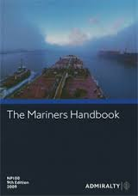
One standard
Notes:
The approach to come to definitions was:
Are there already definitions from IHO, WMO, etc?
If yes, we copy them
If no, we:
Ask the industry for a proposal
Cross check the proposal with existing standards
Cross check if it can work for every port, every trade, in real time
Publish the definition
Good example is the definition related to depths, published in NP100 in March 2015.
Next edition is due November 2016 with definitions re. restrictions.
As this is such an important issue, we therefore recommend to purchase the Mariners Handbook, so both mariners on board vessels, but also ship agents, terminal operators, pilots, VTS, traders etc. etc. all speak the same language.

Slide 13

One information owner

Slide 14
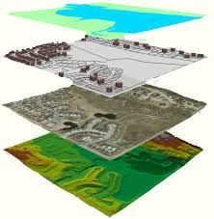
One section
One information owner
Notes:
One department or authority should be responsible for the information, leading to one source of information
And only he/she should has access to change it.

Slide 15
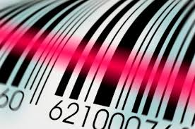
One unique identifier

Slide 16
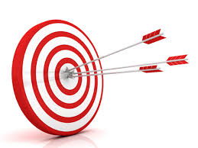
2) Accuracy

Slide 17
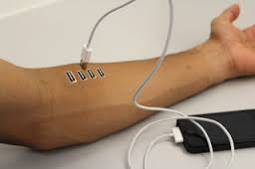
Notes:
Too much human interface will reduce the accuracy of the data.
Having information re. e.g. the accuracy of the sounding equipment available, is very helpful.

Slide 18
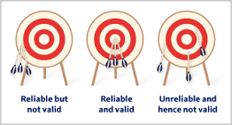
3) Validity
Notes:
Cross checking the information.
Tracking and tracing of changes.
Process to be verified by e.g. Class

Slide 19

4) Completeness

Slide 20

Not too much
Notes:
As every vessel normally sails only to one or two berths, and in order to present the Captain with only the minimum amount of information, capturing information per section and per type of vessel is important.
So he or she only needs to read the sections that applies to that berth and for that vessel.

Slide 21
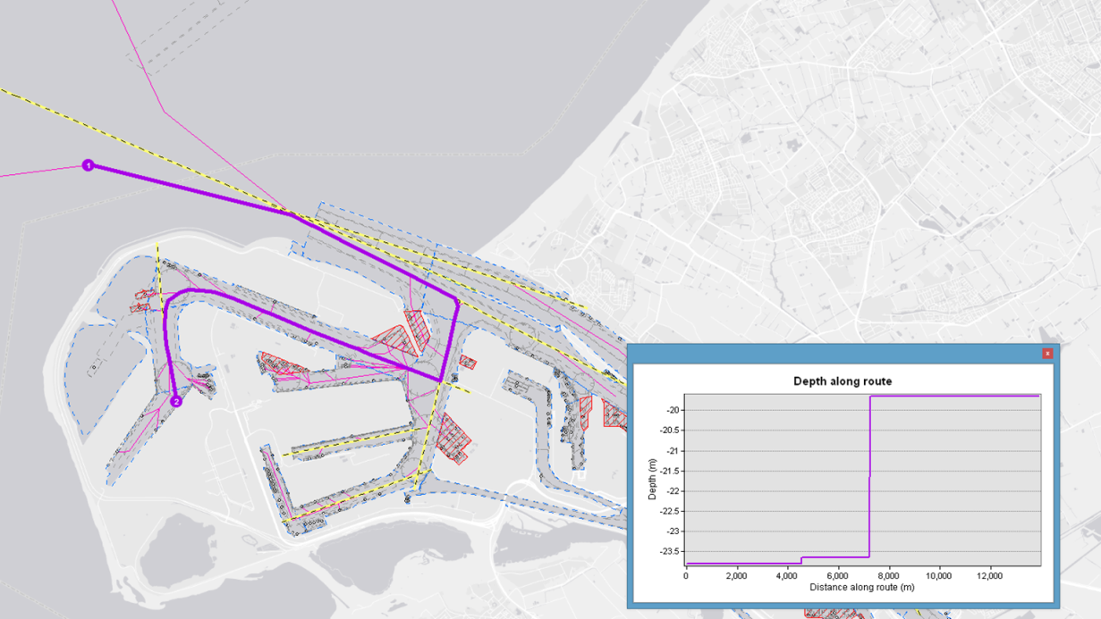
But complete
Notes:
From A to B
Per vessel type
Per vessel size
Selected by typing vessel number and berth number

Slide 22

5) Availability

Slide 23
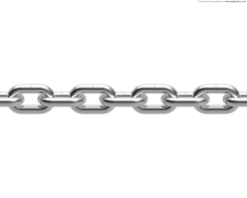
The port has many port data users
Notes:
The port has many different users of information.
If one of them has different information, the discussions start again.
So it’s very important that all parties in the nautical chain are connected to the same information:
Hydrographic offices for publishing charts and books
Private publishers such as LMIU, Bimco
Data bases of shipping lines for planning of vessels
Data bases of traders, brokers, agents for buying and selling cargo, for chartering vessels
Terminals for terminal clearance
Agent, for advising their principals
VTS, for port clearance
Pilots, for their PPU
Etc.

Slide 24
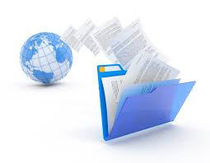
All of them need to be connected
Notes:
So connectivity of data is important.
On top of this, ports like to maintain the data in their own data base, so they can re-use the information for other purposes.
One source of data, that can be exchanged via an open standard is the way forward.

Slide 25
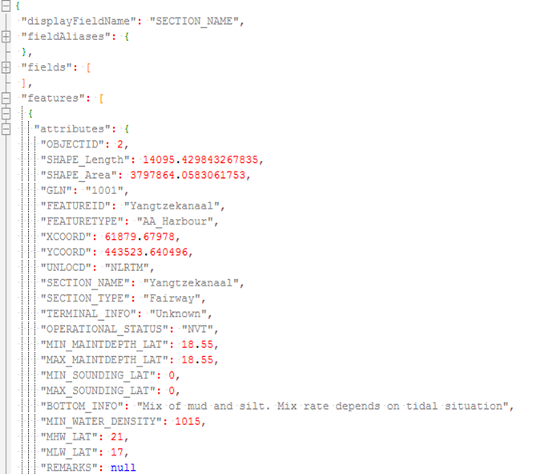

Slide 26
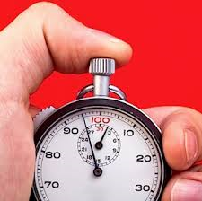
6) Timeliness

Slide 27

Alerts
Notes:
If data has changed, the shipping line likes to be informed immediately.
Again, the impact of this information is much more than we think it is.
So alerts if data has changed, how it changed, when it changed, where it changed, is important.

Slide 28

Summary
Notes:
Port Information Guide word template has been improved re:
Web version versus word template
Lay out re. sequence of information
Lay out re. rich test editors etc.
Definitions
Robust enough to handle all ports that have already completed their Port Information Guide, up to 20 ports
Built and supported by UKHO
Quick production of your own Port Information Guide and link the Port’s website to your on line guide
Parallel to this we have identified:
The needs of ports that need to maintain a lot of data.
The need of customers that data quality is very important
Therefore we continue to work together on an exchange format that will address both issues: allow the port to maintain it’s own data and take care of data quality at the same time.

Slide 29

Other projects
Notes:
EfficienSea is working on uniform exchange of information.
IHMA is connected via BIMCO with this project.
E-nav of IMO is working on the same issues.
Also via EfficienSea we’re connected.
In the end everybody is looking for a one stop shop for all port information.

Slide 30


